Slide 1
Introduction to Node.js: Using Server-Side JavaScript

Slide 2
What is Node.js?
Node.js is a JavaScript runtime environment that executes JavaScript code outside of a browser.
It uses the V8 engine, the same engine that powers Google Chrome, to run JavaScript on the server side.
Built on an event-driven, non-blocking I/O model, making it efficient and suitable for building scalable applications.

Slide 3
Introduction: Basic
In simple words Node.js is ‘server-side JavaScript’.
In not-so-simple words Node.js is a high-performance network applications framework, well optimized for high concurrent environments.
It’s a command line tool.
In ‘Node.js’ , ‘.js’ doesn’t mean that its solely written JavaScript. It is 40% JS and 60% C++.
From the official site:
‘Node's goal is to provide an easy way to build scalable network programs’ - (from nodejs.org!)

Slide 4
Introduction: Advanced
Node.js uses an event-driven, non-blocking I/O model, which makes it lightweight. (from nodejs.org!)
It makes use of event-loops via JavaScript’s callback functionality to implement the non-blocking I/O.
Programs for Node.js are written in JavaScript but not in the same JavaScript we are use to. There is no DOM implementation provided by Node.js, i.e. you can not do this:
var element = document.getElementById(“elementId”);
Everything inside Node.js runs in a single-thread.

Slide 5
Why Use Node.js in MERN Stack?
MERN stands for MongoDB, Express, React, and Node.js.
Node.js serves as the backend of a MERN stack project, handling requests from the frontend (React) and interacting with the database (MongoDB).
The primary advantage is that you can use JavaScript for both client-side and server-side development.

Slide 6
Setting Up Node.js
Install Node.js from the official website
After installation, verify it by running the following commands
node -v
npm -v

Slide 7
Node.js Module System
The module system lets you load external libraries into your application.
That’ll enable you to take advantage of built-in Node.js modules as well as third-party npm modules.
This includes libraries for connecting to database, creating web servers, and more!

Slide 8
Importing Node.js Core Modules
Node.js comes with dozens of built-in modules.
These built-in modules, sometimes referred to as core modules, give you access to tools for working with the file system, making http requests, creating web servers, and more!

Slide 9
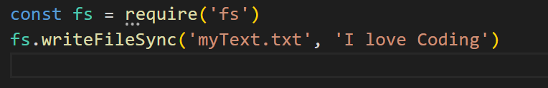
Importing Node.js Core Modules
The module system is built around the require function. This function is used to load in a module and get access to its contents. require is a global variable provided to all your Node.js scripts, so you can use it anywhere you like!
The script above uses require to load in the fs module. This is a built-in Node.js module that provides functions you can use to manipulate the file system. The script uses writeFileSync to write a message to notes.txt.

Slide 10
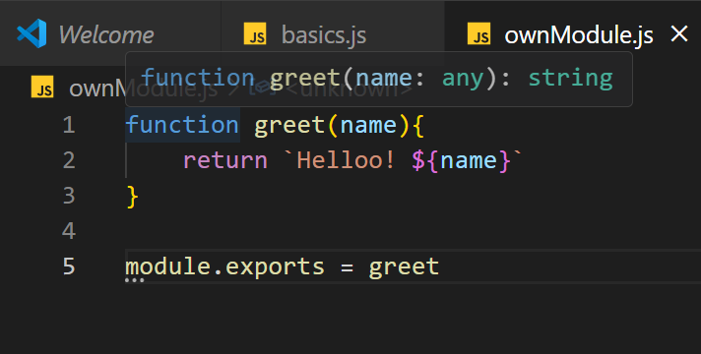
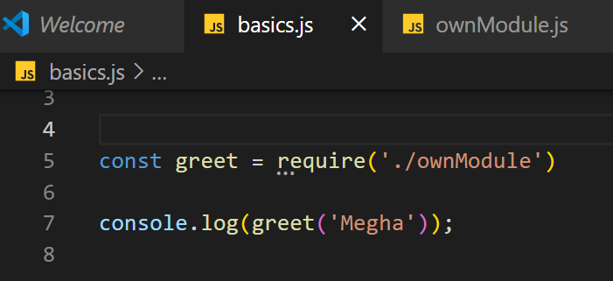
Importing Your Own Files

Slide 11
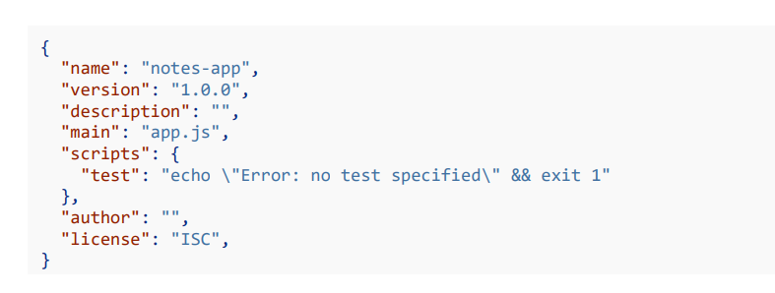
: Importing npm Modules
Your Node.js application needs to initialize npm before npm can be used.
You can run npm init from the root of your project to get that done.
That command will ask you a series of questions about the project and it’ll use the information to generate a package.json file in the root of your project.

Slide 12
: Global npm Modules and nodemon
Installing an npm Module Globally npm modules can be installed globally by adding a -g flag to the installation command.
Not all modules are designed to be installed globally
When you install nodemon globally, you get access a new nodemon command from the terminal. This can be used to start and Node.js application and then restart the application any of the app scripts change.
This means you won’t need to switch between the terminal and text editor to restart your application every time you make a change.

Slide 13

Run : nodemon app.js
Install :
You can stop nodemon by using ctrl + c from the terminal!

Slide 14
Creating a server
One of the most popular Node packages is called Express (it has 22,000,000 weekly downloads!)
It is a minimal web application framework that helps us set up a server and create APIs
https://expressjs.com/

Slide 15
Setting up package.json
First, let’s set up our package.json
Package.json is a universal file in Node.js that contains metadata about the Node packages installed, the project name and description, and other details
Run npm init

Slide 16
Creating a simple server with Express, part 1
Now we can install NPM (Node Package Manager) packages!
Run npm install express to install Express ○ You can read more about Express on their website https://expressjs.com/
This adds stuff to package.json and package-lock.json (a more specific version of package.json we will not touch) and also creates the folder full of our installs called node_modules
To let app.js know to use the Express module, we have to use:
const express = require(“express”);

Slide 17
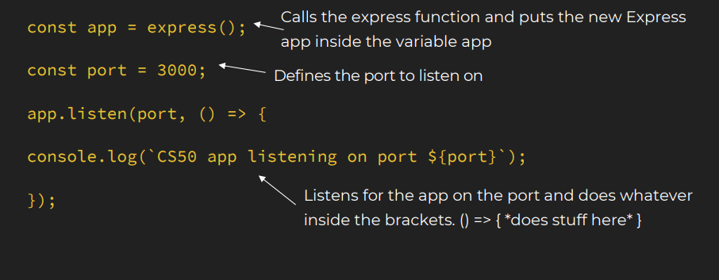
Creating a simple server with Express, part 2

Slide 18
Who is using Node.js in production?
Yahoo! : iPad App Livestand uses Yahoo! Manhattan framework which is based on Node.js.
LinkedIn : LinkedIn uses a combination of Node.js and MongoDB for its mobile platform. iOS and Android apps are based on it.
eBay : Uses Node.js along with ql.io to help application developers in improving eBay’s end user experience.
Dow Jones : The WSJ Social front-end is written completely in Node.js, using Express.js, and many other modules.
Complete list can be found at: https://github.com/joyent/node/wiki/Projects,-Applications,-and-Companies-Using-Node

Slide 19
Tasks
What is Node.js, and how does it differ from traditional server-side technologies?
Why is Node.js preferred in the MERN stack for backend development?
Explain the event-driven architecture of Node.js and its significance.
What is the purpose of the npm (Node Package Manager) in a Node.js project?
How do you create a simple HTTP server in Node.js without using any framework like Express?
What is Express.js, and how does it enhance the capabilities of Node.js?
How can you handle errors in an Express.js application?
What are the common project folder structures used in Node.js, especially for MERN stack projects?
What is RESTful API, and how do you create a simple GET and POST API using Express?
What are environment variables, and how do you manage them in a Node.js application using dotenv?

